Slide 1
Chapter 3
Maximum-Likelihood and Bayesian Parameter Estimation (3,4,5)
Bayesian Estimation (BE)
Bayesian Parameter Estimation: Gaussian Case
Bayesian Parameter Estimation: General Estimation
Pattern Classification Part 2

Slide 2
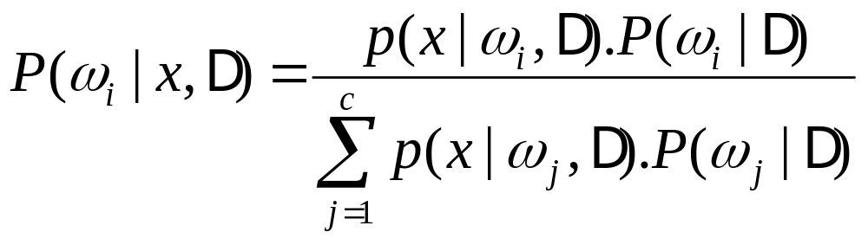
3.3 Bayesian Estimation
In MLE θ was supposed to be a fixed value
In BE θ is a random variable
The computation of posterior probabilities P(ω_{i} | x) lies at the heart of Bayesian classification
Goal: compute P(ω_{i} | x, D)
  Given the sample D, Bayes formula can be written
Pattern Classification Part 2

Slide 3
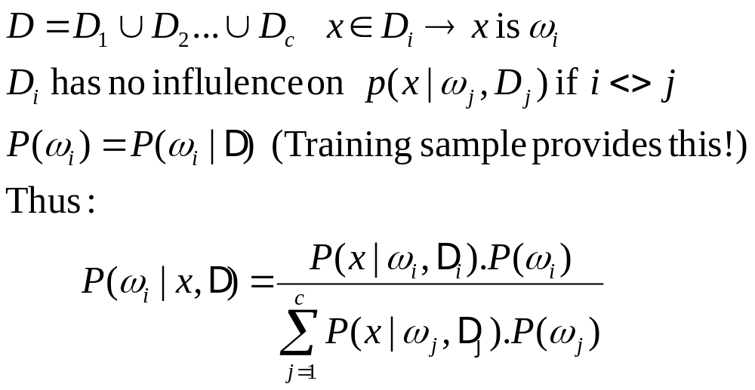
Sample D
likelihood (conditional probability)
posterior probabilities
To demonstrate the preceding equation, we use:
Pattern Classification Part 2

Slide 4
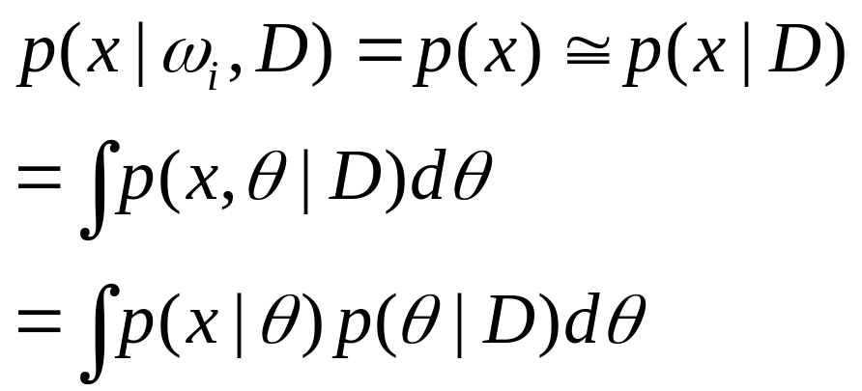


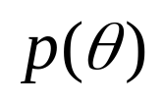
Further illustration
likelihood (conditional probability)
posterior
Key
Key
Unknown and known prior density
Pattern Classification Part 2

Slide 5
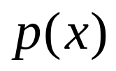


Description of the above illustration
Parameter Distribution
  is unknown, we assume it has a known parametric form , and value of parameter is unknown
  Known prior density
  Training data convert to a posterior density
  Our path:
Pattern Classification Part 2

Slide 6


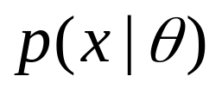
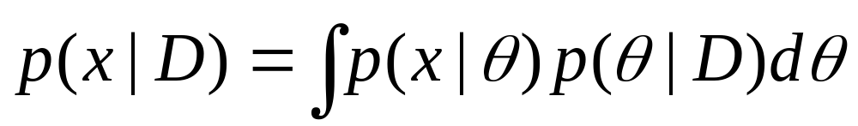
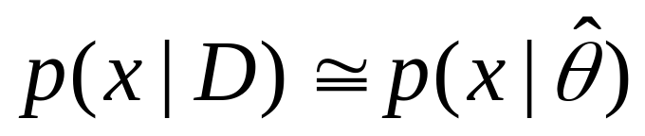
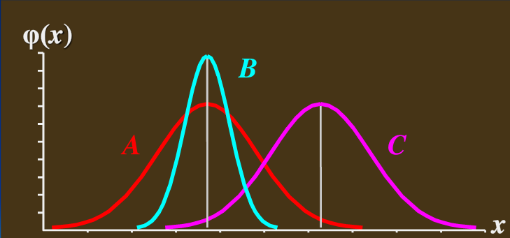
If peaks very sharply about parameter
  and is smooth, and the tails of the integral are not important, then
e.g. the green curve
Pattern Classification Part 2

Slide 7


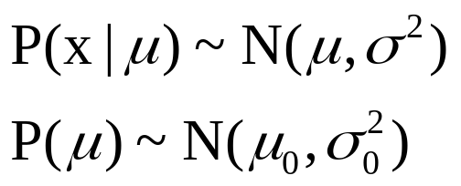
3.4 Bayesian Parameter Estimation: Gaussian Case
Goal: Estimate θ using the a-posteriori density P(θ | D)
The univariate case: P(μ | D)
  μ is the only unknown parameter
  (μ₀ and σ₀ are known!)
Pattern Classification Part 2

Slide 8
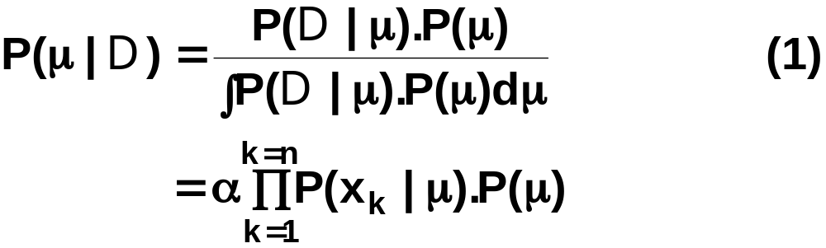


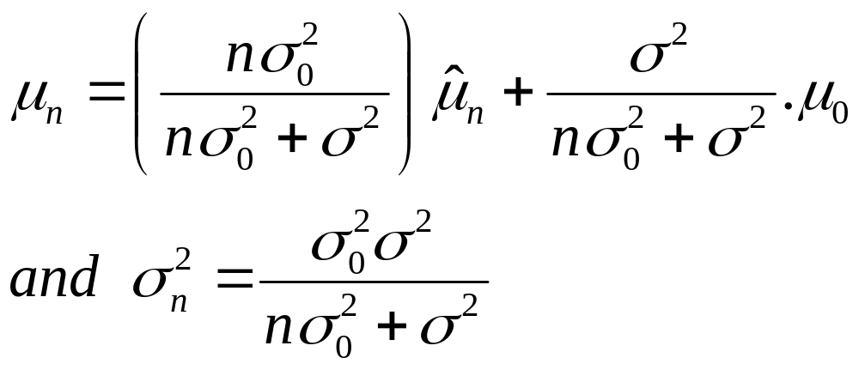
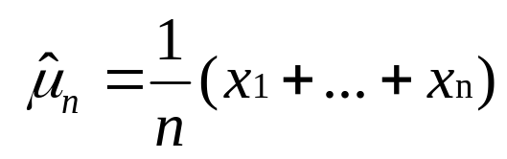
  Reproducing density
  Identifying (1) and (2) yields:
Pattern Classification Part 2
4

Slide 9





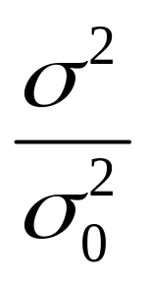
Understanding
  represents our best guess for after observing n samples
  measures our uncertainty about this guess
  Add samples to decrease the uncertainty
  Bayse Learning: as n increase, p(μ | D) becomes more and more sharply peaked, approaching a Dirac delta function as n approaches infinity
Pattern Classification Part 2

Slide 10
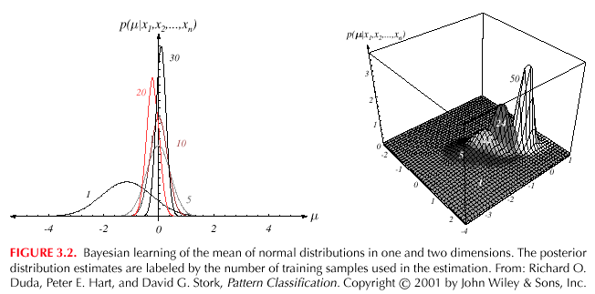


Pattern Classification Part 2

Slide 11

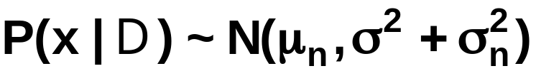

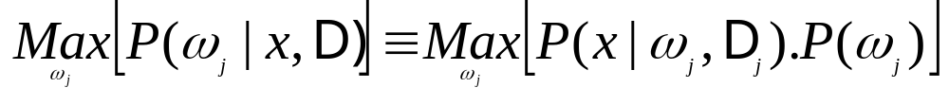
The univariate case P(x | D)
  P(μ | D) computed as above
  P(x | D) remains to be computed!
  It provides:
    (Desired class-conditional density P(x | D_{j}, ω_{j}))
    Therefore: P(x | D_{j}, ω_{j}) together with P(ω_{j}) are known
    And using Bayes formula, we obtain the
    Bayesian classification rule:
Pattern Classification Part 2

Slide 12



3.5 Bayesian Parameter Estimation: General Theory
P(x | D) computation can be applied to any situation in which the unknown density can be parametrized. the basic assumptions are:
  The form of P(x | θ) is assumed known, but the value of θ is not known exactly
  Our knowledge about θ is assumed to be contained in a known prior density P(θ)
  The rest of our knowledge θ is contained in a set D of n random variables x₁, x₂, …, x_{n} that follows unknown P(x)
Pattern Classification Part 2

Slide 13
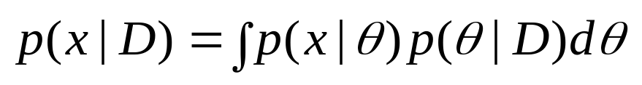
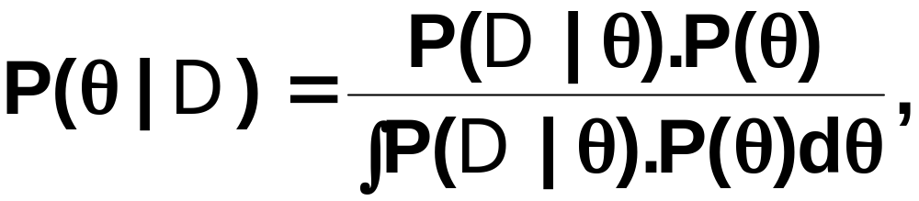
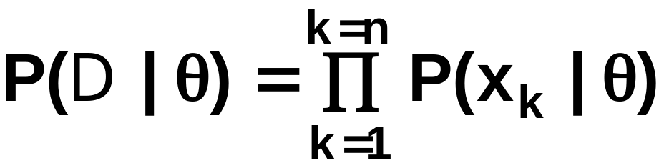

The basic problem is:
“Compute the posterior density P(θ | D)”
then “Derive ”
Using Bayes formula, we have:
And by independence assumption:
Pattern Classification Part 2

Slide 14

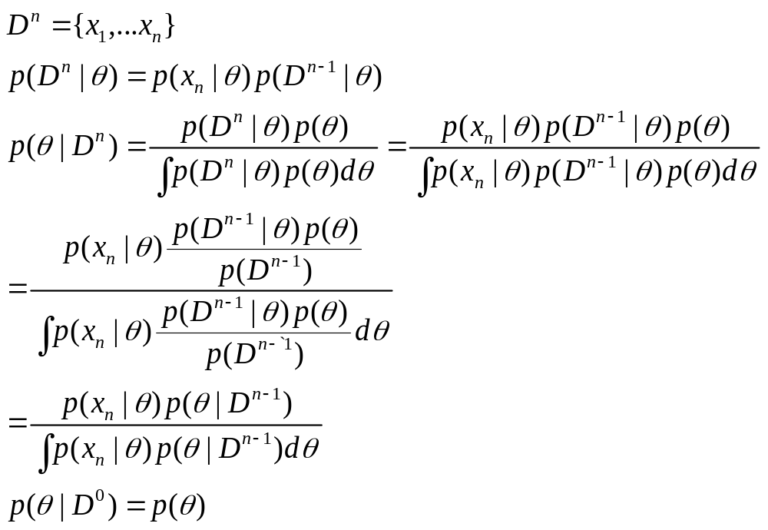
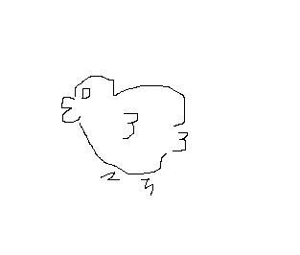
Bayse incremental learning
Pattern Classification Part 2

Slide 15
Maximum Likelihood vs Bayse Estimation
Which is better ?
Pattern Classification Part 2

Slide 16

Maximum Likelihood vs Bayse Estimation
  Computational complexity: ML
  Interpretability : ML
  Confidence in prior information
Source of classification error
  Bayes Error
  Model Error
  Estimation Error
Pattern Classification Part 2

Slide 17

  Drawbacks of ML estimation
    Some observations may be not consistent with the fact
Pattern Classification Part 2

